Slide 1


Team
Tech Titans
presents
Your dreams are now within reach!

Slide 2

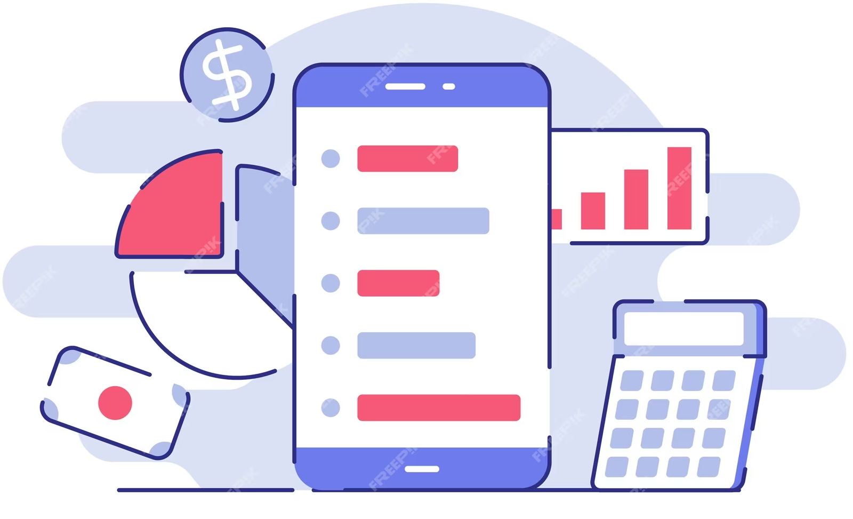
Track My Paisa:
Your Financial Navigator!
All-in-one platform to effortlessly manage your finances . Record expenses, categorize spending, and set meaningful financial goals. From income tracking to expense organization, we provide the tools you need to master your money. Visualize your financial habits, plan your future, and take control of your financial journey with Track My Paisa.

Slide 3




Expense Tracking
Goal Setting
Key Features
Visual Insights
Easily record and categorize your expenses, providing a clear picture of where your money goes.
Income Management
Define your financial objectives, from saving for a dream vacation to paying off debt. We assist in creating achievable plans and milestones to guide you.
Our platform generates charts and reports to offer deep insights into your spending habits and progress towards your goals.
Keep tabs on your income, ensuring you're on the right track to meet your financial goals.

Slide 4
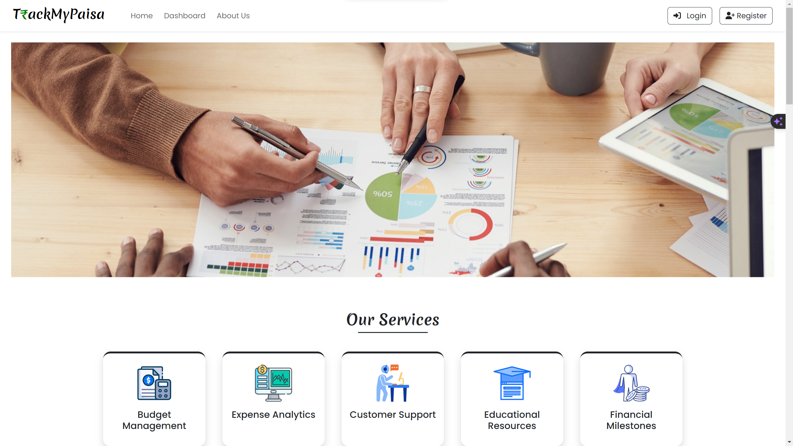
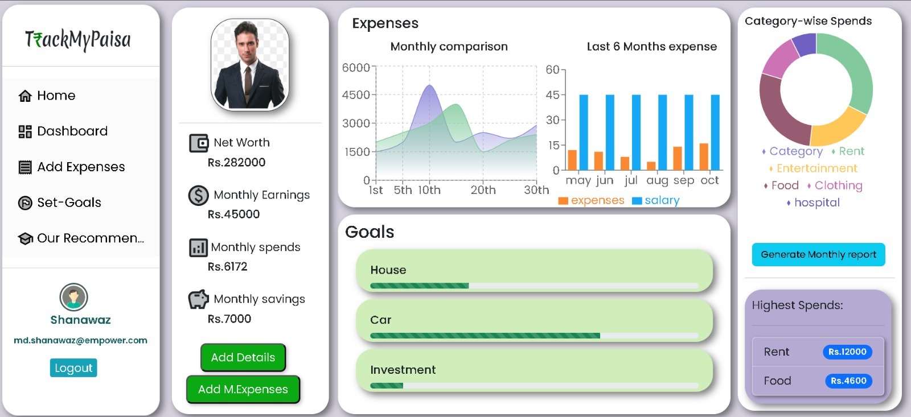
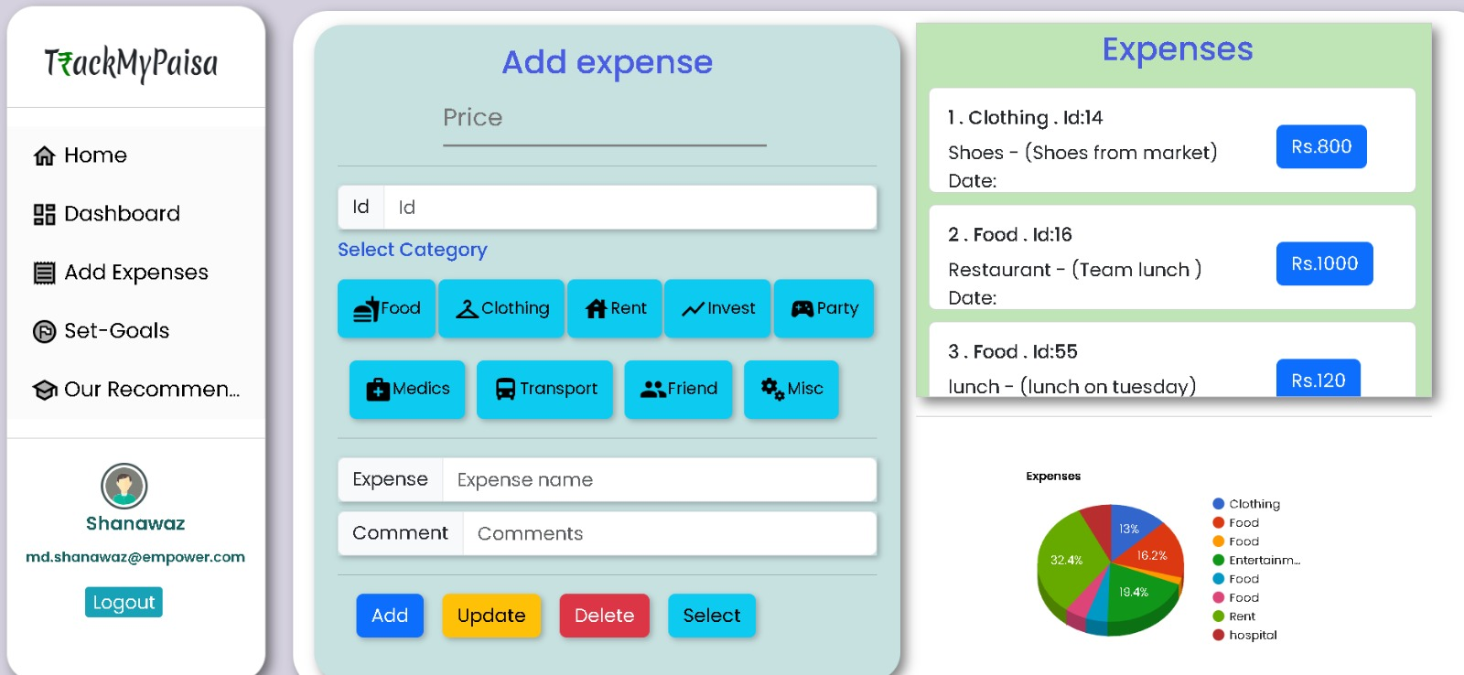
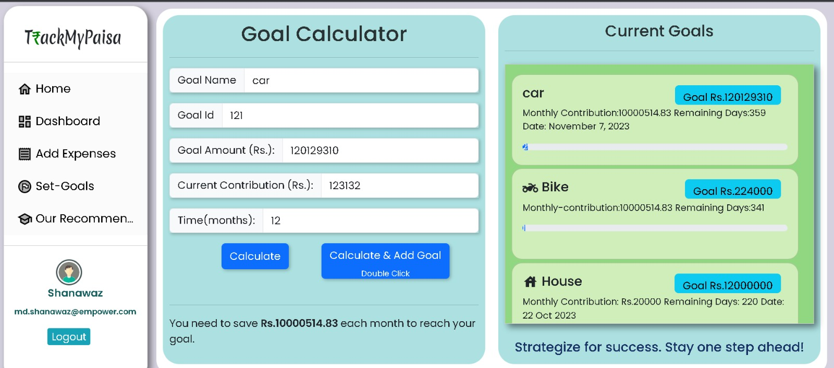
Monitor your personalized reports
Welcome to our Homepage!
Track your Expenses
Set Your Goals

Slide 5









Frontend
Components
Router
Props
States
Styled components
Tools Used
React JS
Bootstrap 5
Backend
Restful web Services
H2 Database
Spring Security
JSON Web Token
Spring Boot
Postman
Swagger

Slide 6

Quick Handson Demo

Slide 7
Thank you!
And we’re open for Q&A
Adarsh Shetty
Dadapeer P
Md Shanawaz
Sushwanth A
Tejas S
Adarsh S
Dadapeer P
Shanawaz MD
Sushwanth A
Tejas s

